Slide 1

Eclipse Imaging Software
Tim Campbell
Ford Amateur Astronomy Club

Slide 2
Topics
Safety Disclaimer
Netting it out - the problem & solution
Essential Gear
Software & Features
Eclipse Basics
Scripts
Demo
Q & A

Slide 3
Safety

Slide 4
Safety
Have and use these
during the eclipse…
…to avoid needing one of these
after the eclipse.
Any Questions?

Slide 5
Netting it Out

Slide 6
The “Problem”
The entire eclipse will require several different exposures for
  The Chromosphere
  Shadow Bands
  Diamond Ring
  Baily’s Beads
  The Solar Corona
  Don’t forget shots of the crowds (and maybe even you)

Slide 7
The “Problem”
Odds of getting all these exposures right on your first attempt?
How much time will you need to dedicate with your head in your gear?
Think you’ll still experience and enjoy the live event?

Slide 8
The “Solution”
Automation of exposure adjustments for image acquisition across multiple cameras
Automatic control of precise timing of image capture for each phenomena
This sounds a lot like the sort of problem that computers can handle.
… if only software existed that did this.

Slide 9
It does exist!

Slide 10
Mac
Windows
Eclipse Orchestrator
  Free (with limited capabilities for noncommercial use)
  Pro (license unlocks full functionality)
  $109 USD for Pro
Solar Eclipse Maestro
  Freeware (for non-commercial use)
  Donations Accepted
  Full functionality in free version
  100€ full license

Slide 11
How it Works (Simplified)
Critical exposures are based around amount of sun covered by moon at any given point in time.
Exposures are well understood based on timing of the “Contacts”
Timing can be worked out to astonishing precision if your precise location and time of day are also known to a high degree of precision.

Slide 12
Essential Gear

Slide 13
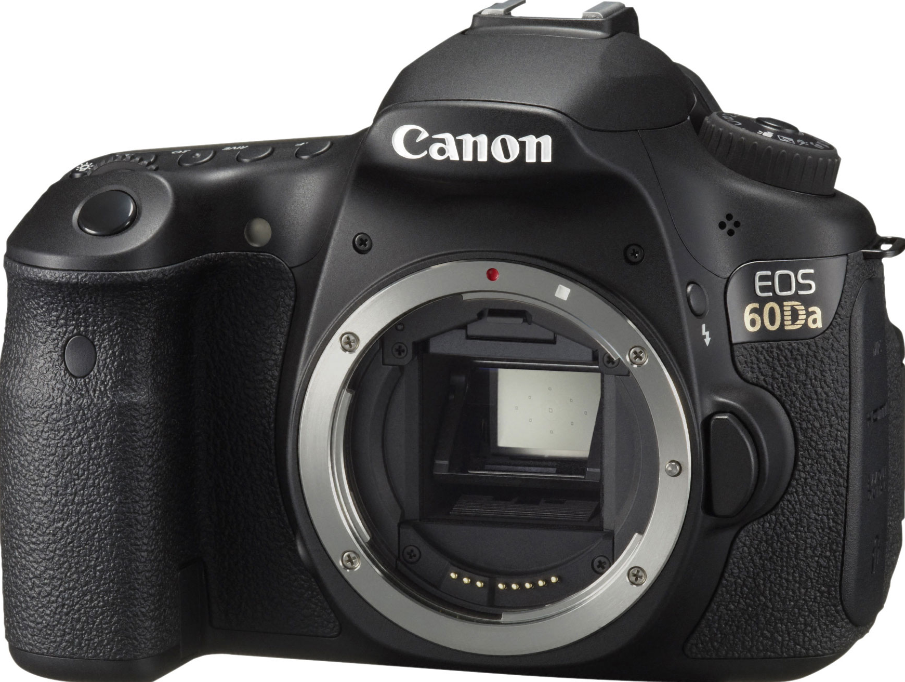
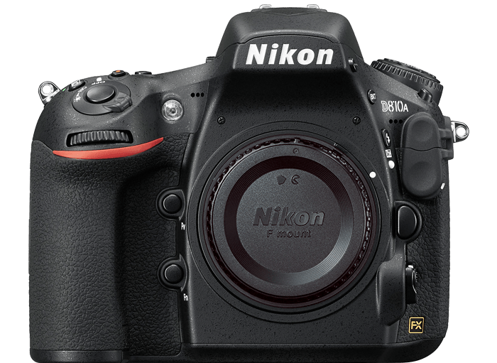
Compatible Camera
Check the supported camera list.
Most Canon or Nikon DSLR models are supported.
Other brands are not supported.

Slide 14
Memory Cards
Camera Limits Card Types and Sizes Supported
Cameras supporting SDHC can support up to 32GB
Cameras supporting SDXC can support up to 2TB

Slide 15
Fresh Batteries
Insert fresh batteries before the eclipse to insure that you have enough power to last through the entire event.

Slide 16
Camera Tethering Cable(s)
Tether Tools 15’ USB Tether Cable $37
(available on Amazon)
Monoprice 15’ USB Tether Cable $6
(available on Amazon)
Preferably longer than the factory USB cables that probably came with your camera.

Slide 17
Computer
(and an adequate way to power it)
It may be possible to get a power adapter that will run your laptop on 12v battery power if your internal laptop battery is not adequate.
Total Eclipse duration from 1st Contact to 4th Contact is about 3 hours.

Slide 18
USB Hub*
About $10
(available on Amazon)
*If your computer doesn’t have enough available USB ports.

Slide 19

Camera Lens(es) or Telescope
(with appropriate focal length)
1/4
Minimum
1/3
Nominal
1/2
Maximum
 | Minimum | Nominal | Maximum
Full Frame | ~625mm | ~850mm | ~1250mm
APS-C | ~400mm | ~525mm | ~800mm

Slide 20
Using a Tele-Extender
Exercise Caution: Here be dragons!
 | Minimum | Nominal | Maximum
Full Frame | ~625mm | ~850mm | ~1250mm
APS-C | ~400mm | ~525mm | ~800mm
Tele-extenders can create internal reflections. While usually
not visible in ordinary photography, the intense brightness
of the sun may reveal these and ruin your photos.
Test: Shoot a crescent moon at +6 to +10 stops with
moon near edge of frame. If tele-extender creates internal
reflections, they should be visible on opposite side of image.

Slide 21
Solar Filters
Preferably ND 5.0 (software must support ND factor)
Cap style: Filter’s inner-diameter must be fractionally larger than outer-diameter of lens or telescope barrel.
Thread style: Filters are available in several common camera thread sizes.

Slide 22
Tracking Mounts
Losmandy StarLapse
~$700 USD

Slide 23
Tracking Mounts
Sky Watcher
Star Adventurer
~$300 USD Motor Base Only
~$400 USD Nicely Equipped*
* with wedge and
counterweight system

Slide 24
Tracking Mounts
iOptron
SkyTracker Pro
~$300 USD

Slide 25
Tracking Mounts
Motorized (tracking) telescope mounts will, of course, also work.
Make sure you have appropriate adapter to attach camera to your scope and that camera can achieve focus*.
*often a problem with scopes using Newtonian reflector design.

Slide 26
Software & Features

Slide 27
Windows
Eclipse Orchestrator
Written to run with Windows XP or Vista
Feature | Free | Pro
Simultaneous Camera support | 1 | 16
Max frames per second | ~0.3 | Unlimited
Script Wizard phenomena | 2 | 10
GPS time accuracy | < 1 sec | < 0.1 sec
Bulb support | no | yes
Mirror lock-up support | no | yes
Live-view support | no | yes

Slide 28
Mac
Solar Eclipse Maestro
Written to run with Mac 10.4 through 10.12 (10.11 recommended)
PPC or Intel (Intel recommended)
Feature | Freeware | Paid
Simultaneous Camera support | 4 | 4
Max frames per second | Unlimited | Unlimited
Script Wizard phenomena | 10 | 10
GPS time accuracy | < 0.1 sec | < 0.1 sec
Bulb support | yes | yes
Mirror lock-up support | yes | yes
Live-view support | yes | yes

Slide 29
Eclipse Basics

Slide 30
Eclipse Basics
Sun’s diameter is about 400x larger than moon’s diameter.
Sun is also about 400x farther away than moon.
This means Sun & Moon both appear to be similar size (1/2º from edge to edge)
Moon distance varies from 356,000km to 406,000km (about 50,000km)
This determines if eclipse is annular vs. total and length of totality.

Slide 31

Events Based on Time-offsets from Significant Contacts
C1 - Moon first touches
Sun’s disk - Eclipse begins
C2 - Moon covers
Sun’s Disk - totality begins
C3 - Moon covers
Sun’s Disk - totality ends
C4 - Moon exits Sun’s
disk - End of eclipse

Slide 32
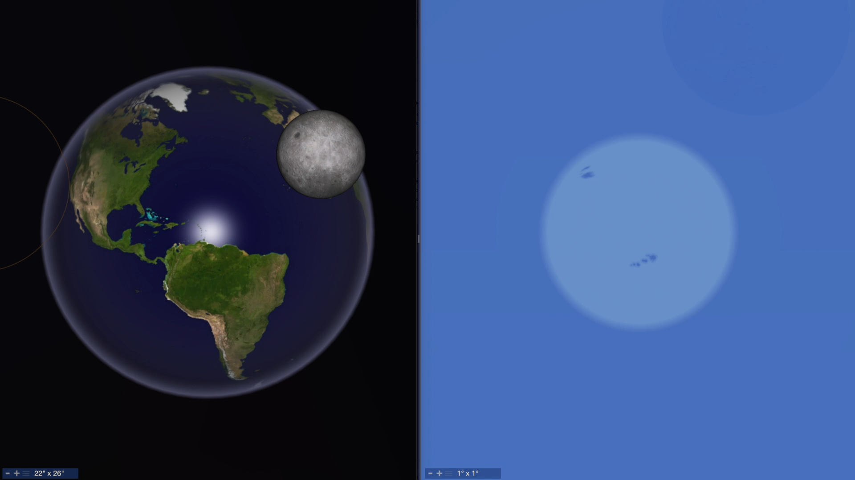
Simultaneous Views from Ground and Space

Slide 33
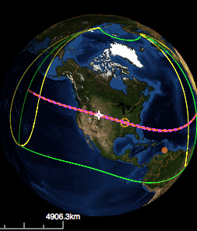
What the software does - Part 1
Determine Precise Time for Each Contact
Need precise latitude, longitude & altitude.
Need precise time of day.
Can then calculate precise moment of C1, C2, C3, & C4

Slide 34
What the software does - Part 2
Scripted capture of phenomena based on time relative to the contact events
Periodic images of partial eclipse phases before & after totality between C1 & C2 and again between C3 & C4
Diamond Rings
9 seconds before C2
9 seconds after C3
Baily’s Beads
1.5 seconds before C2
1.5 seconds after C3
Solar Corona
between C2 and C3 (exposing about 12 stops worth of dynamic range)
Yell at photographer to remove and later re-attach filters
at just the right moments before C2 and after C3 (Very important!)

Slide 35
Scripts

Slide 36
Automation is primarily script-driven
Configuration wizard will typically auto-generate an initial script (usually for one camera only).
Script is just a text file. You can edit this with any text editor.
You should review and modify the script as desired (especially if you have multiple cameras).

Slide 37
Script Format
TAKEPIC,MAX,-,00:49.2,Canon 60Da,1/640,8.0,200,0.000,RAW,None,N,Solar corona Rs = 0.1
Action,Reference Event or Date,Offset Sign,Time,Camera Name,Shutter Speed,Aperture,ISO,Mirror Lock-Up Time,Image Quality,Image Size,Incremental,Comment
Action: What do you want it to do?
Reference Event: RISE, C1, C2, MAX, MID, C3, C4, SET
Offset Sign: +, - (relative to reference event)
Time: Offset time relative to reference event
Camera name: Which camera are we using for this action?
Shutter speed: Duration of exposure in seconds
Aperture: f-stop (for lenses with automatic aperture control)
ISO: Camera ISO setting
Mirror Lock-Up Time: Allow vibrations to settle after raising reflex mirror before capturing exposure.
Image Quality: You will only ever want to use ‘RAW’
Image Size: You will use ‘None’ (camera will shoot at native size)
Incremental: Y, N Should it only update the setting which has changed from previous exposure?
Comment: Notes so you can remember why you wanted this line in the script

Slide 38
What does this do?
TAKEPIC,C2,-,00:09.0,Canon 60Da,1/80,8.0,200,0.000,RAW,None,Y,First Diamond Ring
Action: TAKEPIC = Tell the camera to take a picture
Reference Event: C2 = Second Contact (start of totality)
Offset Sign: ‘-‘ = do this before C2
Time: 00:09.0 = do this 0 minutes and 9 seconds before totality
Camera name: Using the camera named ‘Canon 60Da’ (you choose the name)
Shutter speed: 1/80 = Take a 1/80th second exposure
Aperture: 8.0 = Use f/8
ISO: 200 = Use ISO 200Bas
Mirror Lock-Up time: 0.000 = Don’t wait for vibrations to settle (no mirror lock-up delay)
Image Quality: RAW = Use ‘RAW’ format (instead of JPG)
Image Size: None = Don’t resize
Incremental: Y = Only tell camera what changed for this exposure relative to last exposure
Comment: First Diamond Ring = Note to self on why I put this line in the file

Slide 39
What does this do?
PLAY,C2,-,00:00:20.1,Filters_Off.wav, , , , , , , ,'Filters off' voice prompt
Action: PLAY = Play a “.wav” file (audio clips)
Reference Event: C2 = Second Contact (start of totality)
Offset Sign: ‘-‘ = do this before C2
Time: 00:00:20.1 = do this 0 hours 0 minutes and 20.1 seconds before totality
Camera name: Filters_Off.wav (used for file name since this isn’t a camera command)
Shutter speed: n/a
Aperture: n/a
ISO: n/a
Mirror Lock-Up time: n/a
Image Quality: n/a
Image Size: n/a
Incremental: n/a
Comment: Note to self on why I put this line in the file - yell at photographer

Slide 40
  Lots of Commands
Commands are available for numerous scripted actions…
  Shoot live-video (movies)
  Take bracketed sequences
  Take burst sequences
  Execute ‘loops’
  And much much more (see documentation for full details)

Slide 41
General Setup & Use
Choose the eclipse (software knows about many events)
Establish location (lat/lon/alt position)
Define gear (cameras)
Create script & edit to taste
Load Script (open/edit scripts doesn’t necessary “load” them into the simulation engine. You must “load’ the script to test it or use it.
Use simulation mode to test

Slide 42
  Simulation Mode
Intended to help you practice. Validate that everything works as expected.
Set a simulation time typically based on Contacts (C1, C2, C3, C4), Sunrise, Sunset, or any arbitrary time you choose.
Script executes and performs actions based on simulated time & location “as if” you are there.

Slide 43
Fred Espenak’s Tips - Part 1
15 mins before C2 - swap battery & memory card
5 mins before c2 - check focus accuracy
1 min before C2 - check focus & framing
At least 10 but not more than 50 secs before C2 remove filters but do not look through camera until totality begins.
During totality - do not attempt to make changes… enjoy the eclipse.

Slide 44
Fred Espenak’s Tips - Part 2
10 seconds after C3
  Replace solar filter immediately after camera captures 2nd Diamond Ring effect
  Watch moon’s shadow recede to the east
Immediately following conclusion of eclipse
  Lock & label memory cards
  Store in a safe place
  Make plans for next eclipse.

Slide 45
Fred Espenak’s Tips - Part 3
Place a tarp on the ground and set up a yellow caution tape around the tarp to establish a boundary.
Do not approach eclipse photographers closer than 6’ unless they invite you.

Slide 46
Fred Espenak’s Tips - Part 4
Eclipsis-Ineruptis
Do not stand between someone’s camera or telescope and the Sun
Do not interrupt someone who is busy adjusting his/her gear
Do not disrupt others with questions during totality
Do not ask for the time or how much time is left during totality
Do not play music

Slide 47
Demo

Slide 48
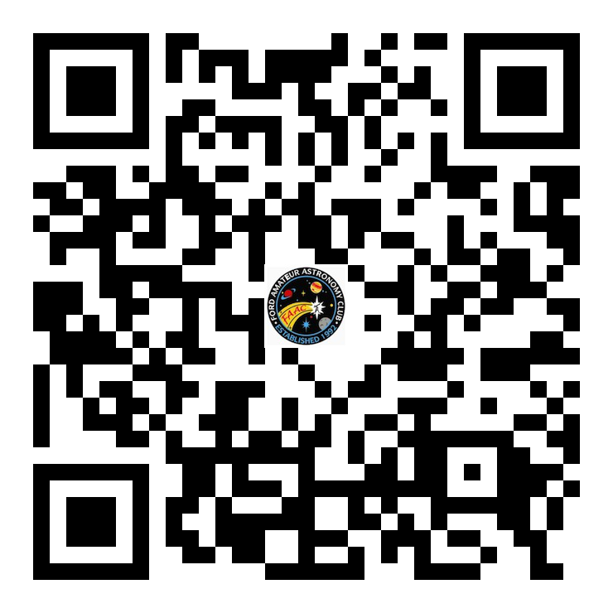
Q & A
Download this presentation at fordastronomyclub.com
Scan the QR code above.

